Slide 1
KAUNISTATUD PAGARITOOTED
Eve Leimann
KHK
KPAo15

Slide 2
https://cuteyummytime.wordpress.com/2009/05/23/cute-panda-pig-doraemon-cakes-from-london-bakery-animal-birthday-cakes-cute-dessert-decoration/

Slide 3
https://cuteyummytime.wordpress.com/2009/05/23/cute-panda-pig-doraemon-cakes-from-london-bakery-animal-birthday-cakes-cute-dessert-decoration/

Slide 4
https://www.facebook.com/more.idey/photos/a.155940761184454.28778.152114361567094/487942904650903/?type=3&theater

Slide 5
https://www.facebook.com/more.idey/photos/a.155940761184454.28778.152114361567094/449112191867308/?type=3&theater

Slide 6
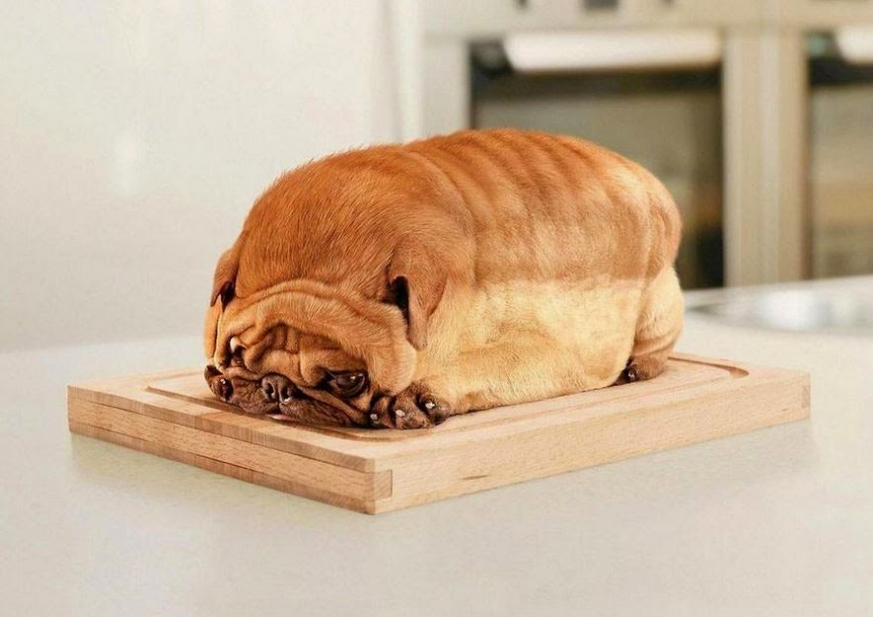
http://www.thebreadhunter.com/2014/11/bulldog-loaf-of-bread.html?gclid=CjwKEAiA2IO0BRDXmLndksSB0WgSJADNKqqoEJxdi11c8us_OqGmXjGfkZMENUTxgmO18yhgOrqtSRoCF2rw_wcB

Slide 7
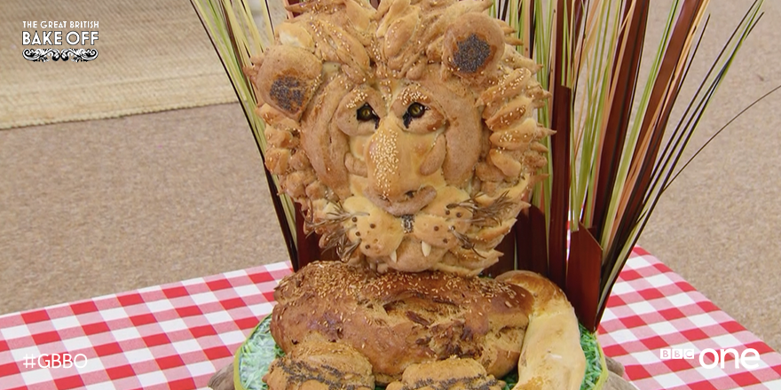
https://www.facebook.com/BBCOne/photos/pcb.997991776887907/997991593554592/?type=3&theater

Slide 8
https://www.facebook.com/more.idey/photos/a.155940761184454.28778.152114361567094/436962923082235/?type=3&theater

Slide 9
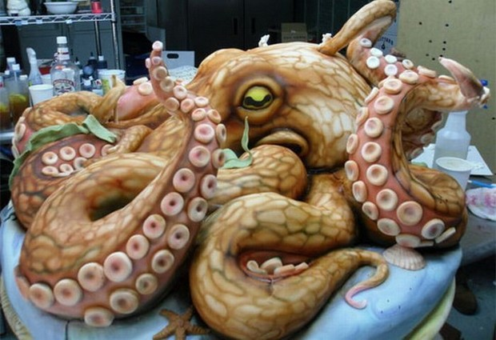
http://netodd.com/food/incredibly-decorated-cakes/

Slide 10
http://rushcitybakery.com/mypictures/Cookies%20N%20Cupcakes/C-20%20Cookie%20Critters.jpg

Slide 11
http://www.dreamstime.com/royalty-free-stock-photography-isolated-ukrainian-festive-bakery-image3883417

Slide 12
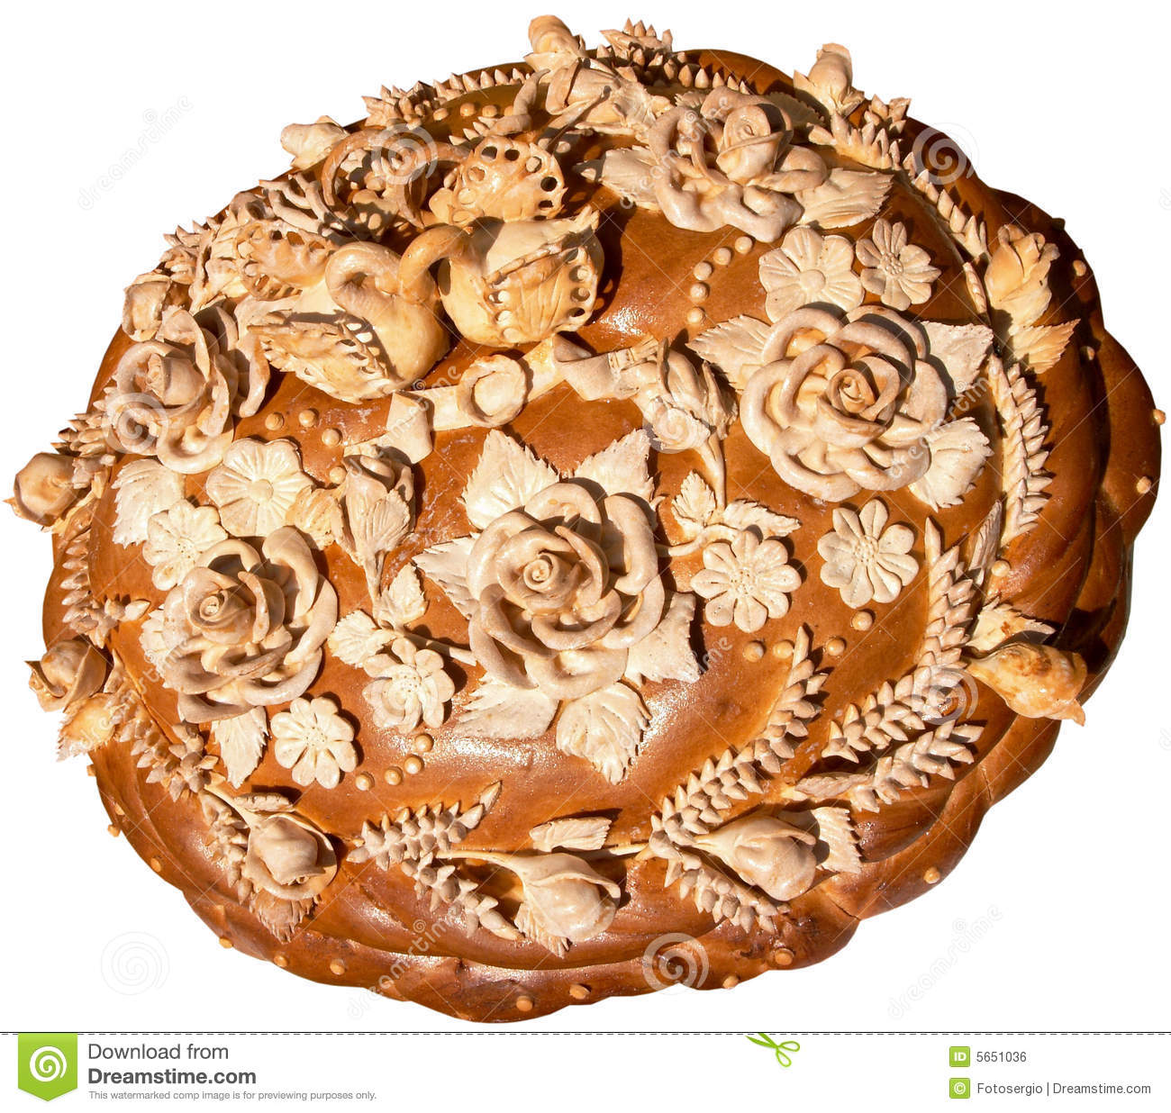
http://www.dreamstime.com/royalty-free-stock-image-isolated-ukrainian-festive-bakery-holiday-bread-8-image5651036

Slide 13
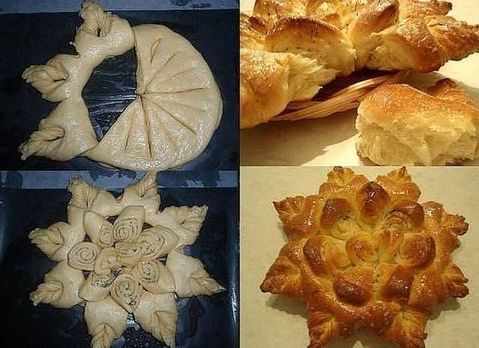
https://www.facebook.com/more.idey/photos/a.155940761184454.28778.152114361567094/750877915024066/?type=3&theater

Slide 14
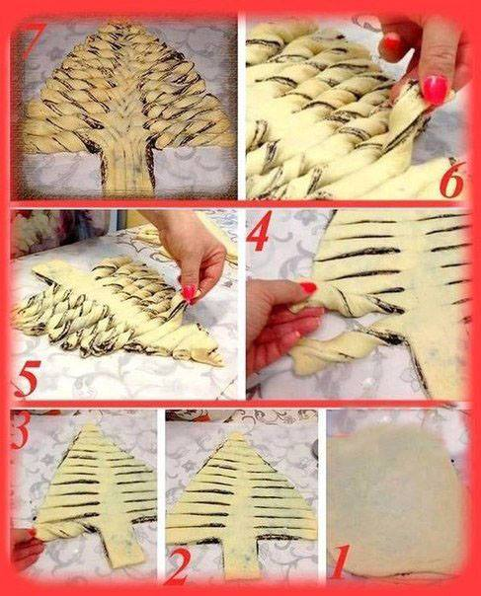
https://www.facebook.com/more.idey/photos/a.155940761184454.28778.152114361567094/448353935276467/?type=3&theater

Slide 15
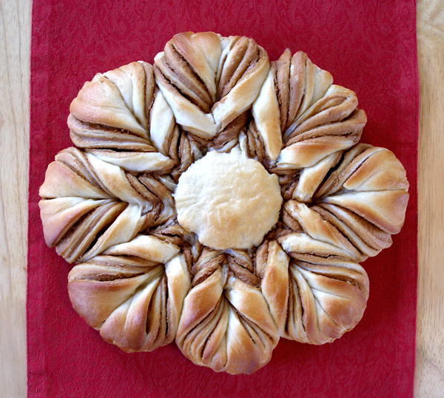
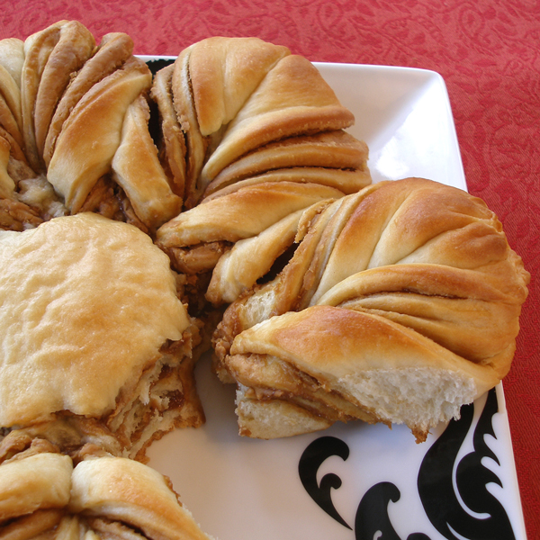
https://www.craftybaking.com/recipe/cookie-butter-filled-star-loaf

Slide 16
https://www.facebook.com/more.idey/photos/a.501856156592911.1073741924.152114361567094/711566572288534/?type=3&theater

Slide 17
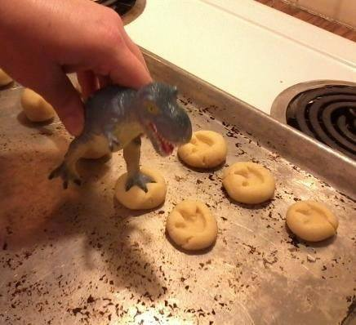
https://www.facebook.com/PeeweeHerman/photos/a.165846999055.149547.55264489055/10154411004814056/?type=3&theater

Slide 18
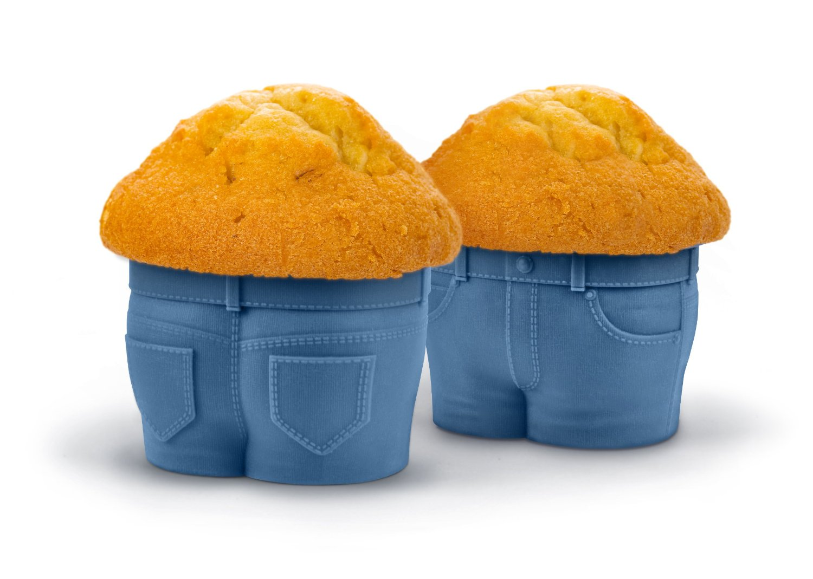
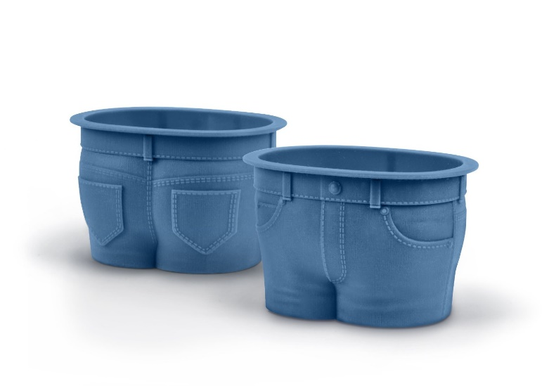
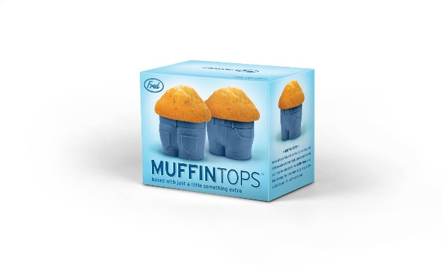
http://www.amazon.com/gp/product/B00EIFXCA8/ref=as_li_ss_tl?ie=UTF8&camp=1789&creative=390957&creativeASIN=B00EIFXCA8&linkCode=as2&tag=shesaid-20

Slide 19
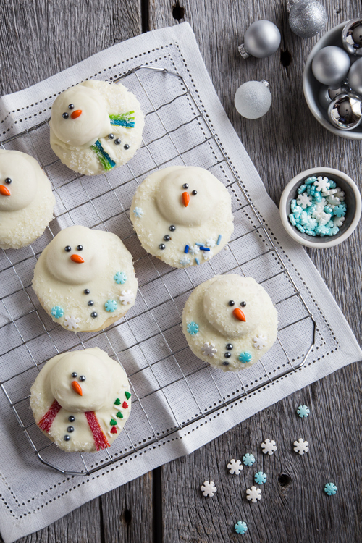
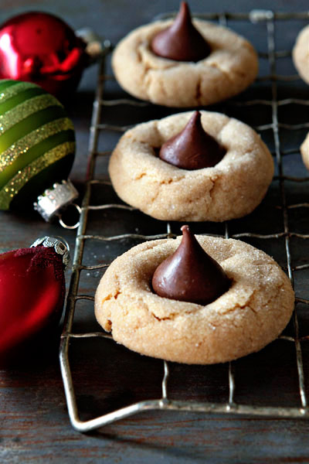
http://www.mybakingaddiction.com/melting-snowman-cookies/
http://www.mybakingaddiction.com/peanut-butter-blossoms/

Slide 20
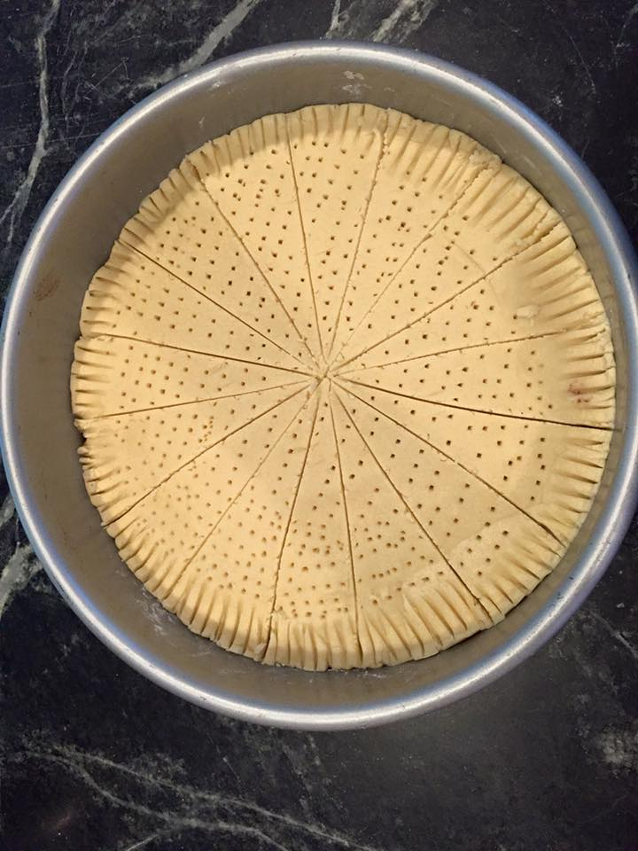
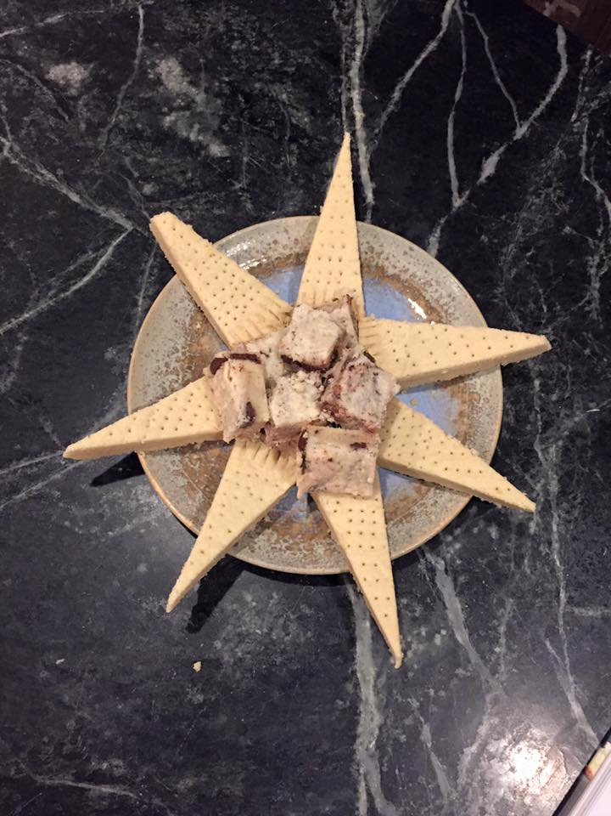
https://www.facebook.com/bluejeanchef/photos/pcb.10156335043530007/10156335036110007/?type=3&theater

